Slide 1
Arduino Workshop #6
The I²C bus
Notes:
24 – Arduino Uno
24 – USB Cable
24 – Red LED
72 – Yellow LED
96 – Green LED
192 – 220 Ω resistor
48 – 4.7 kΩ resistor
24 – SN74HC595N shift register DIP IC
24 – TC74A0-5.0V AT I2C Temperature sensor
24 – Jumper Wire sets
24 – Breadboards

Slide 2
PowerPoint and Code
Github.com/EELabMan
Go To Repositories and find Arduino 6 I2C bus

Slide 3
Standardizing Integrated Circuits
We will look at the common I²C protocol
Pronounced “eye squared see” or “eye two see”
Invented in the 1980’s by Philips
Allowed relatively low speed communications for various IC’s\
Standardized in the 90’s
Other companies adopted and released compatible chips
Generally known as “two wire”
Because two wires lines are used for communications\
A data and a clock
I²C is a trademarked name
Think Kleenex vs Tissues
If an electronic item says “two wire compatible” it will be fairly certain to be I²C compatible

Slide 4
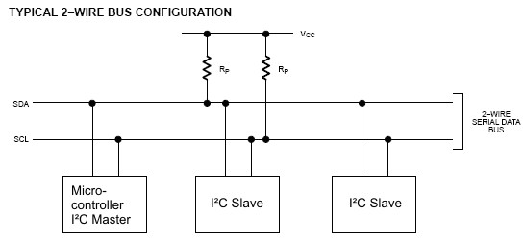
I²C Hardware Design
I²C is unique in that it can handle multiple devices
All share the same communication lines
A clock signal (SCL)
Bidirectional data line
Used to send data back and forth between the master and slave (SDA)
Notice that the I²C bus requires pull-up resistors on both data lines

Slide 5
Hardware and pull up resistors
The value of the needed pull up resistors
Depends on the slave devices
Number attached and individual needs
Specified on Data sheet
4.7 ㏀ is fairly standard (and what we will be using)

Slide 6
Communication Scheme and ID numbers
I²C can have multiple devices to share communication lines with a single “master” device
The Arduino will act as the master device
Responsible for initiating all communications
Slave devices can not initiate communication only respond to requests from the master
If not -- the communication line would be overwhelmed and data would drop

Slide 7
Naming and communication
Each slave device has a unique 7-bit address (ID)
Some I²C devices have selectable addresses
Some I²C devices have a fixed address (from the factory)
Temperature sensors are commonly preprogrammed with various IDs (to facilitate more than 1 sensor on a single bus)
When communication is initiate
An ID is transmitted
The slave device reacts to data on the bus only when it’s directed at their ID

Slide 8
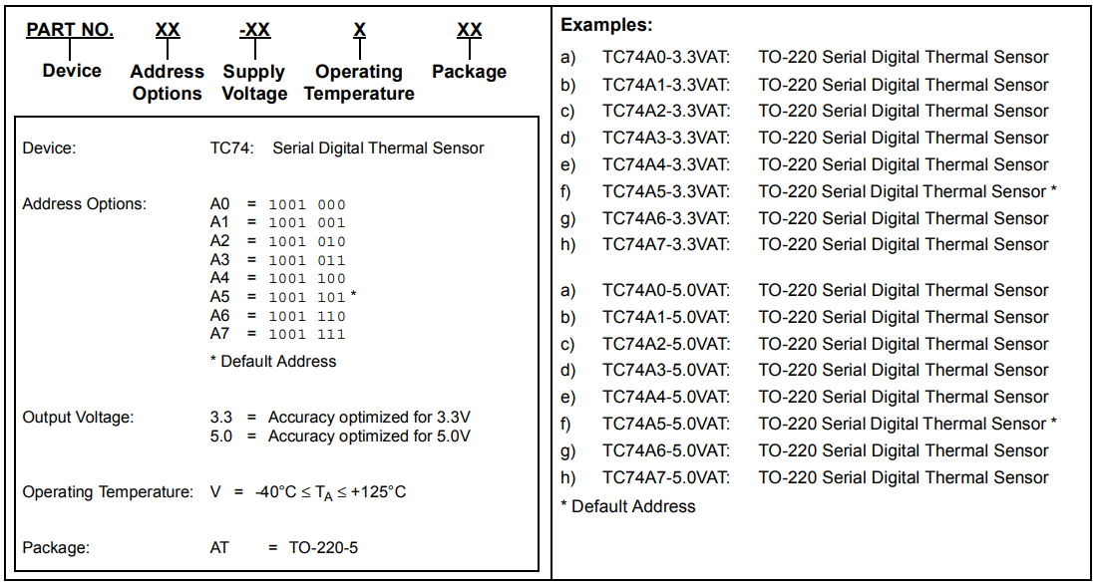
TC74 temperature sensor

Slide 9
Things to notice from the Data sheet
Notice from this manufacture
You can purchase eight different ID numbers
You could put 8 of them on 1 I²C chip and read them independently
As you are writing the program to interface w/ your temp sensor later… be aware of its ID

Slide 10
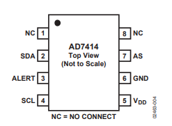
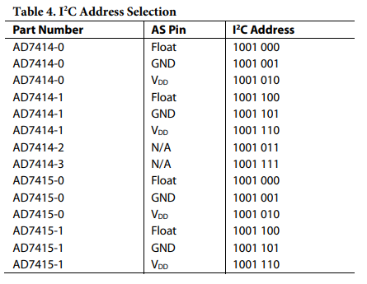
Address selectable I²C
Some chips (AD7414 and AD 7415) have address select (AS) pins
Allows you to configure the address of the device
Below we see AD7414 has an “AS” pin with 3 possible ID numbers
Depending on whether “AS” pin is left disconnected, is tied to VCC, or grounded

Slide 11
Communicating with I²C temp probe
Steps vary for different chips (with different requirements for different devices)
Thankfully Arduino I²C library can be used to abstract away most of the difficult timing work
Basic steps though are:
Master sends a start bit
Master sends 7-bit slave address of device it wants to talk to
Master sends read (1) or write (0) bit
Depending on the desired action
Slave responds with an “acknowledge” or ACK bit (a logic low)
Data is handled
In write mode
Master sends 1 byte of info at a time
Slave responds ACK
In Read mode
Master receives 1 byte of info at a time
Responds to slave with ACK

Slide 12
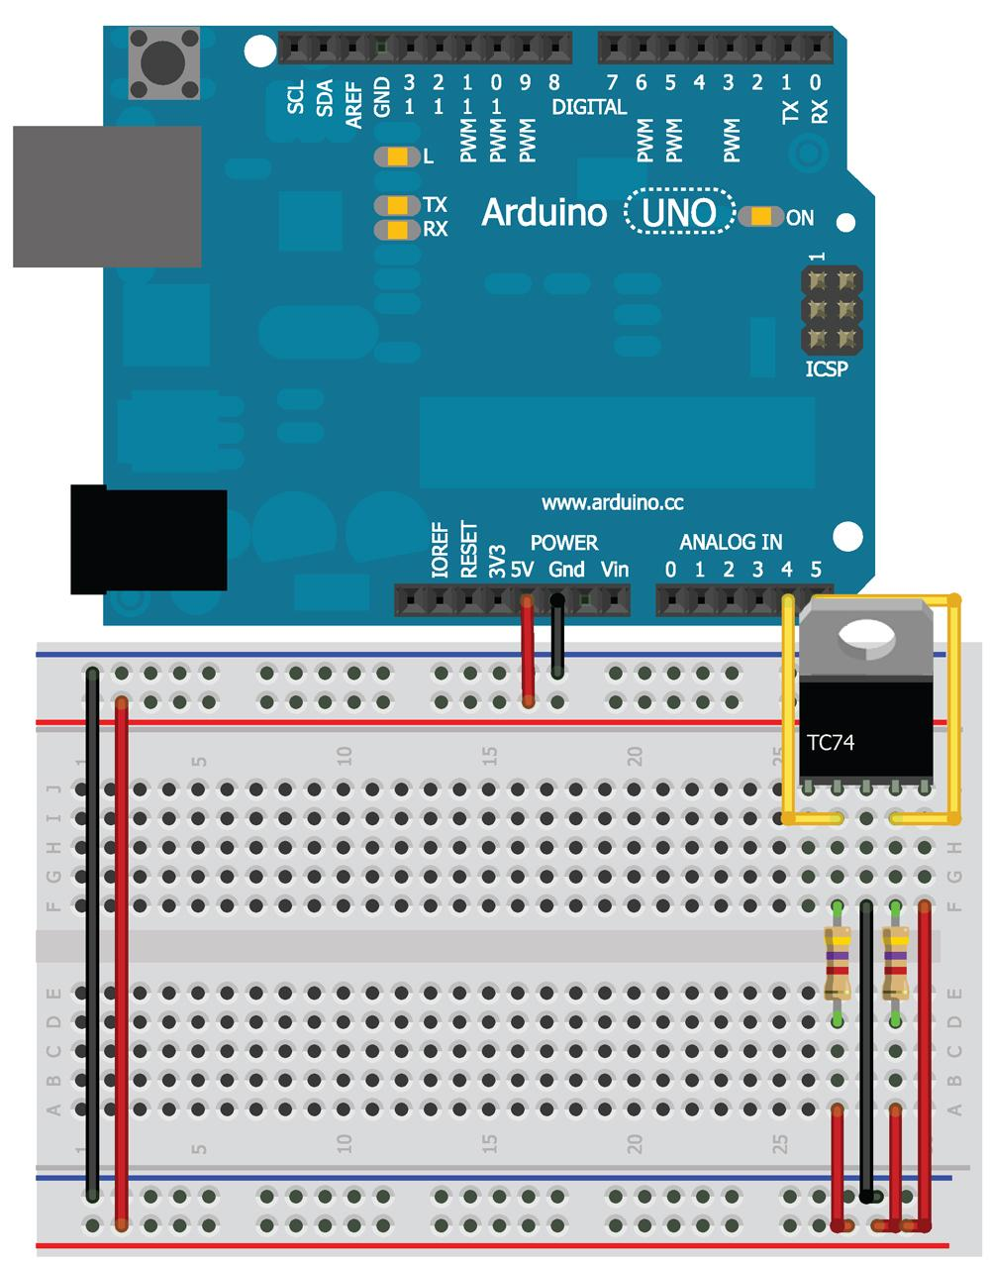
Wire it up

Slide 13
Things to note
You can use the serial to print out temps
Its a digital signal
no conversion needed to see the data as a degrees reading
SDA and SCL are wired to pins a4 and a5
They carry data and clock signal
Recall A4 and A5 are multiplexed pins
Between ADC and hardware I²C
When you initialize the wire library
Those pins connect to the ATMega’s I²C controller
Enabling with the Wire object to I²C device via those pins
This means you can't use these pins as analog inputs and use the wire directory
They are reserved for communication with I²C devices

Slide 14
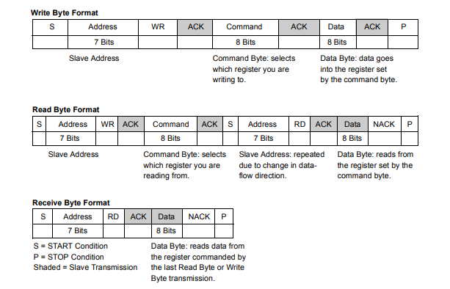
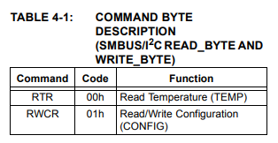
Before you can code an I²C device
You need to know the communication scheme
You need to know how to read the datasheet to determine this
Using what you already know about how I²C works

Slide 15
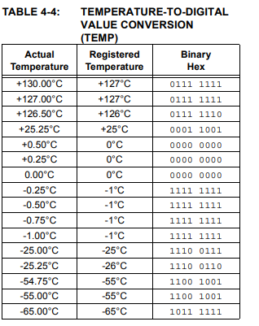
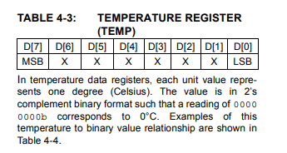
The takeaway from those two tables
You can both read and write to this I²C
As shown in the first table
The TC74 has 2 registers
Current temp (in ⁰C)
Contains configurable info about the chip (inc. standby state and data ready state)
In order to read the temp we can look at table 4-3 and 4-4

Slide 16
The setup of our code
The read byte section earlier outlines the process we should follow to read the temperature
Send to the device’s address in write mode and write “0” to indicate you want to read from the register
Send to the device’s address in read mode and request 8 bits (1 bite) of information from the device
Wait to receive all 8 bits
When in doubt about how to properly code a device - google is your friend (search for code examples that show what you need)

Slide 17
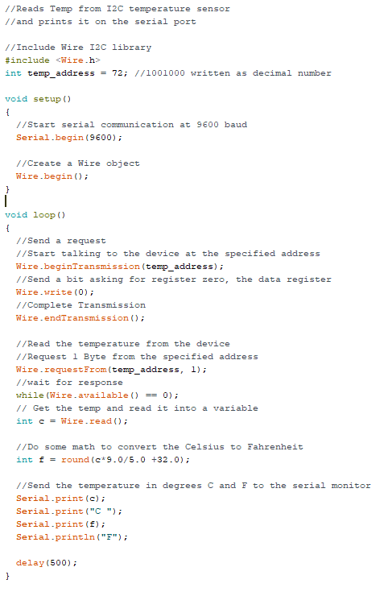
The Code
Download read_temp.ino from GitHub.
Wire.beginTransmission()
starts communication w/ a slave with the given ID
Wire.write()
sends 0 indicating you want to read from the temperature registry
Wire.endTransmission()
sends the stop bit
wire.requestFrom()
prepares the master to receive 1 byte of data from the slave
Wire.available() [within the while loop]
blocks the program from executing the rest of the code until data is available on the I²C line
Wire.read()
The 8 bit value is read as an integer
The last section converts the temp into freedom units

Slide 18
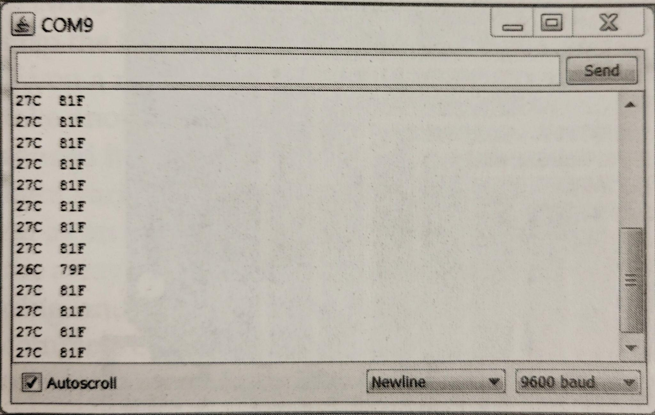
What you should see

Slide 19
Temp monitoring system

Slide 20
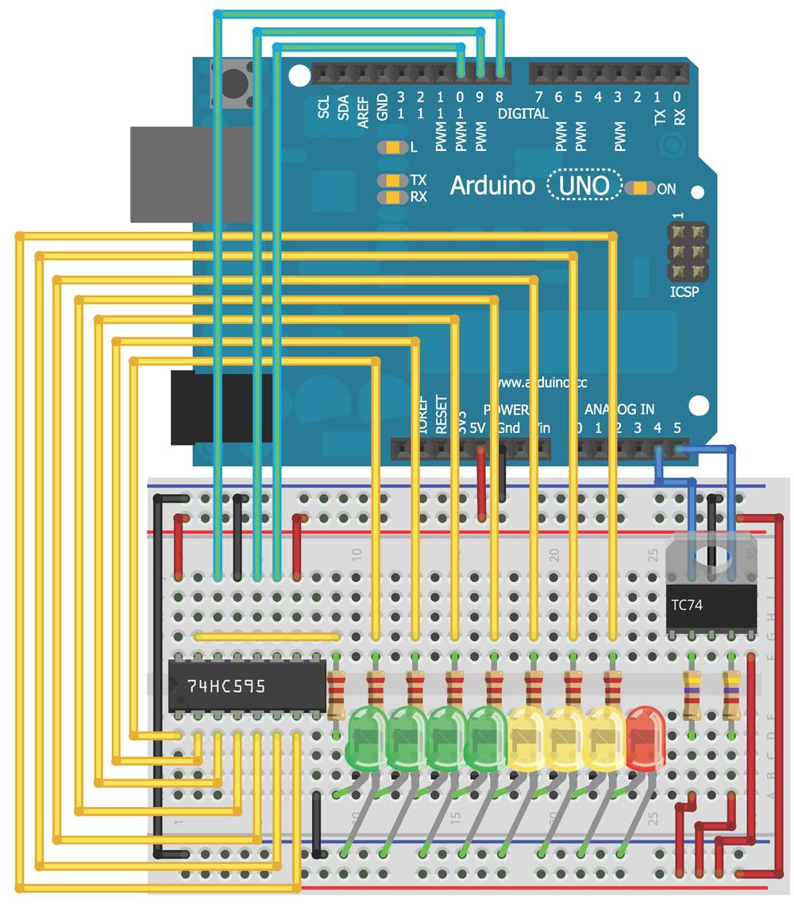
Wire the arduino

Slide 21
Minor modification of previous program
The print statements should read
Serial.print(c);
Serial.print(“C,”);
Serial.print(f);
Serial.print(“F.”);
This allows you to easily parse the temps by the delimiting character (“,” and “.” respectively)
Next we need to add a shift register code (from last session)and mao the LEDs to the appropriate levels (the code given chose 24⁰C to 31⁰C but you can choose any level that works best for the room)

Slide 22
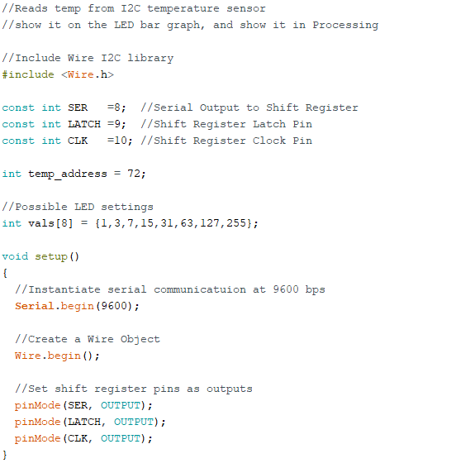
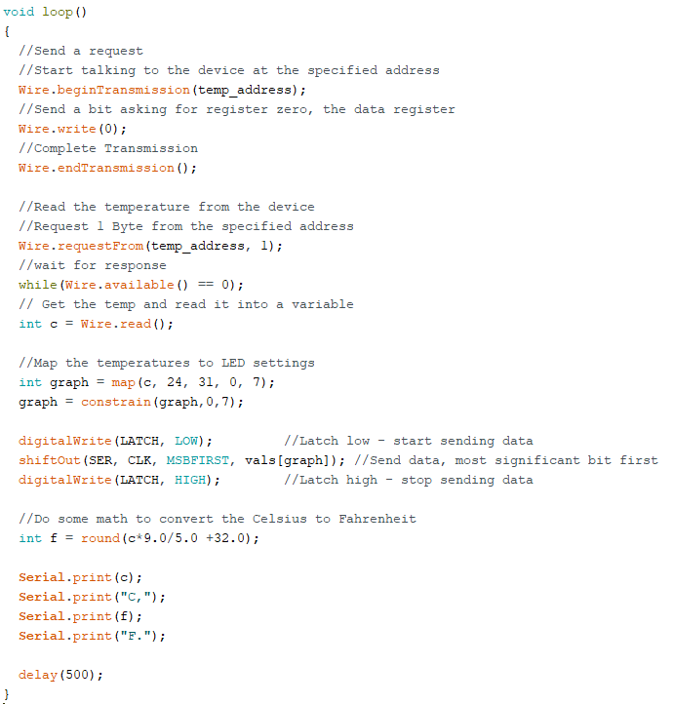
The Code
Part 1
Part 2
Download temp_unit.ino from GitHub

Slide 23
You should see
The LEDs light up and if you squeeze the temp sensor with your fingers making the temp go up, the LED’s should respond

Slide 24
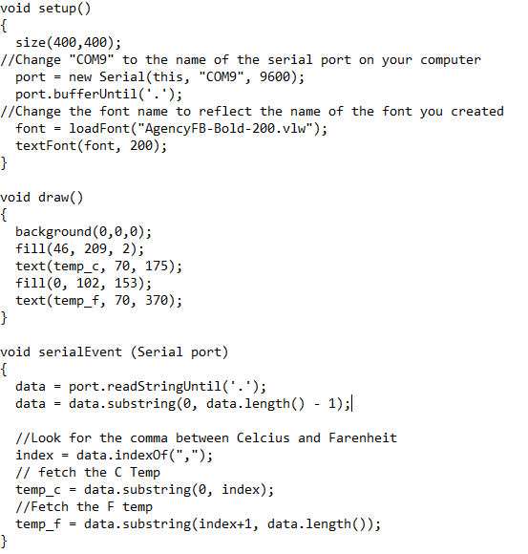
Writing a Process sketch
Download from GitHub
Things to change
The com port needs to match the computer
Pick a font you enjoy
Pick a font size that you want
Arduino Serial Monitor must be closed

Slide 25
Stay tuned
Arduino 7 will cover the SPI bus.
We’ll wire two Digital Potentiometers!

